Slide 1
CIS355A Course Project Sky Landscaping JAVA App
By: Warren Sky

Slide 2
Introduction
In this project I designed and created a JAVA GUI program representing a Landscaping company order system.
This program allows for taking an order, collecting and managing customer information, adding and removing customer and order information in a database.

Slide 3
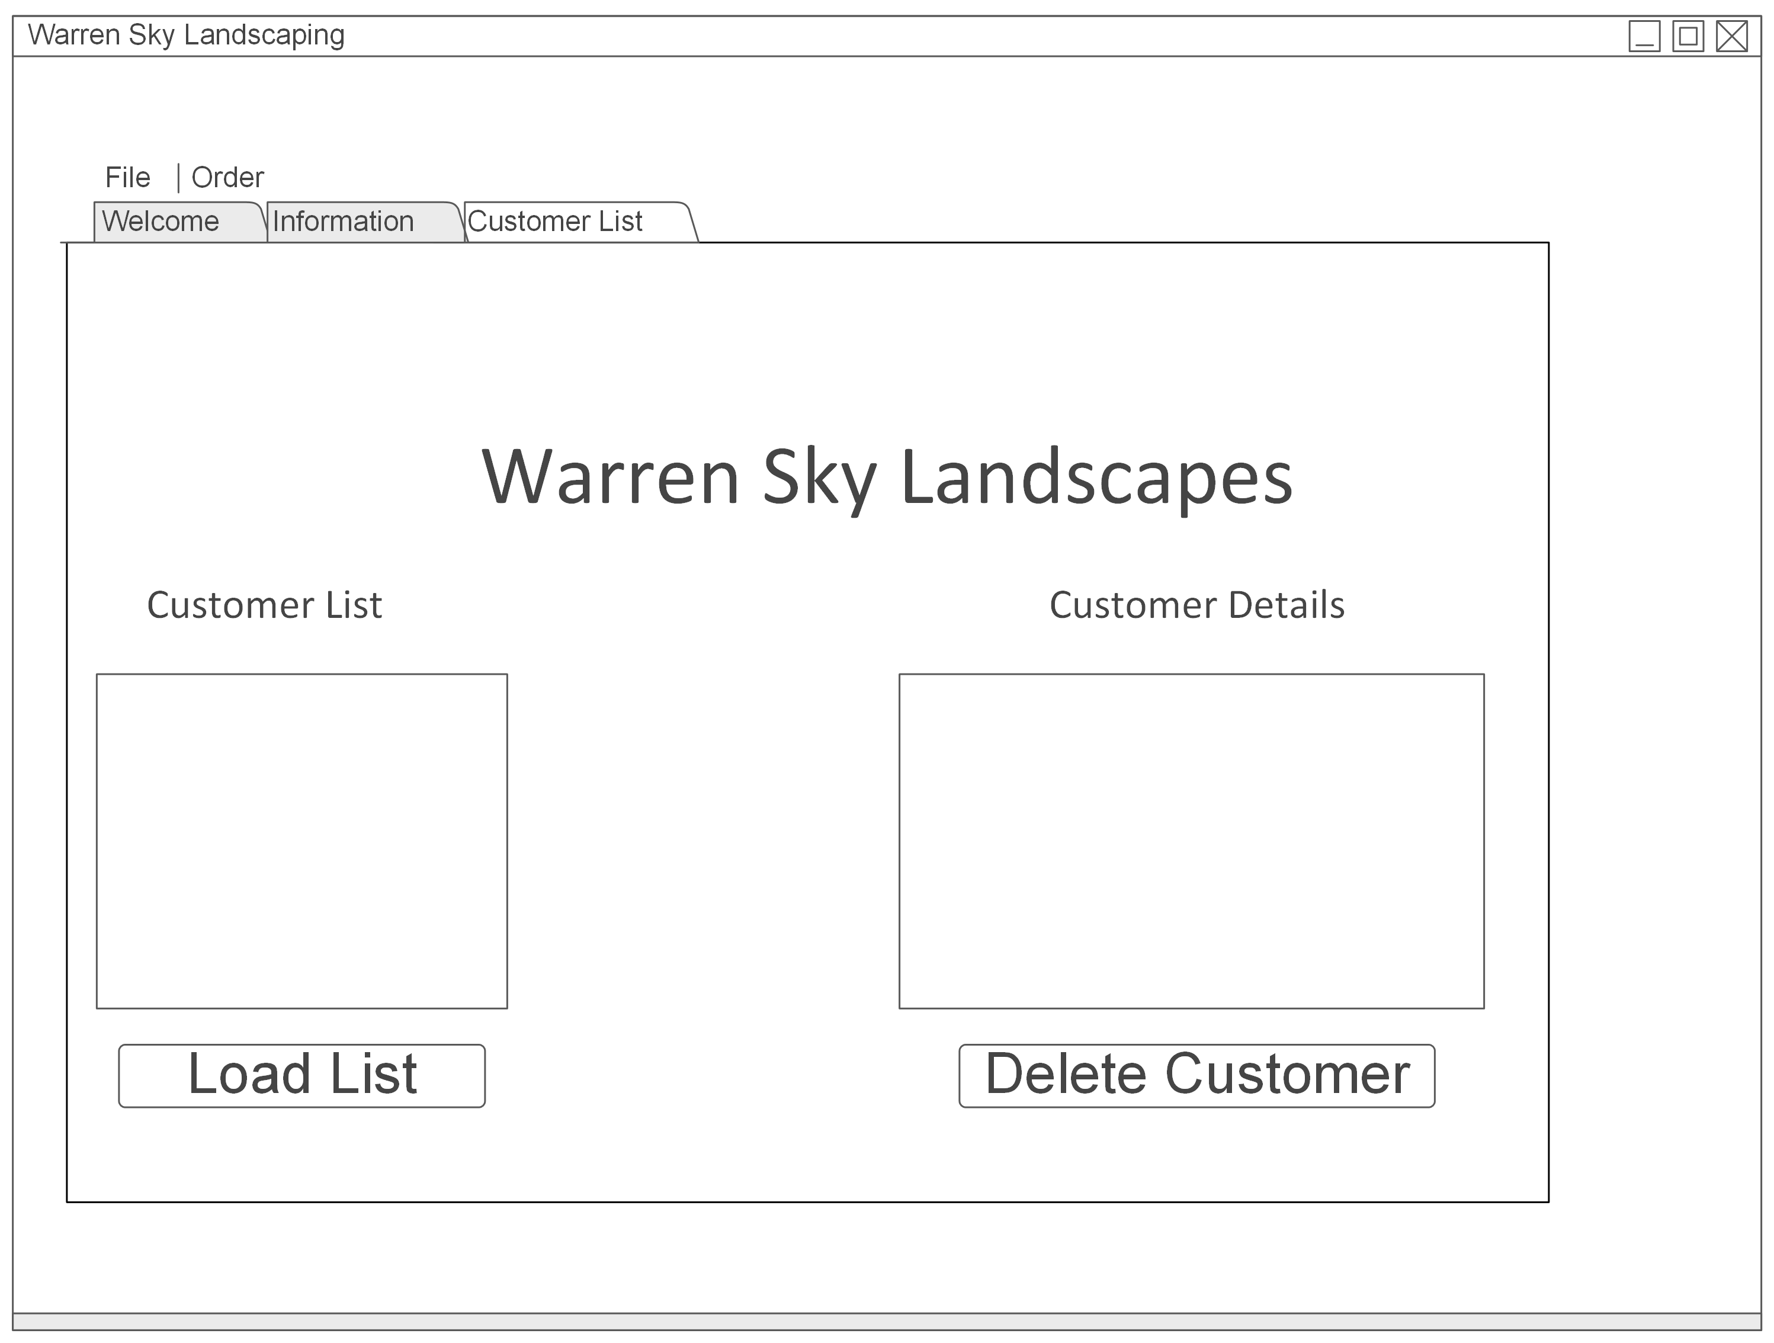
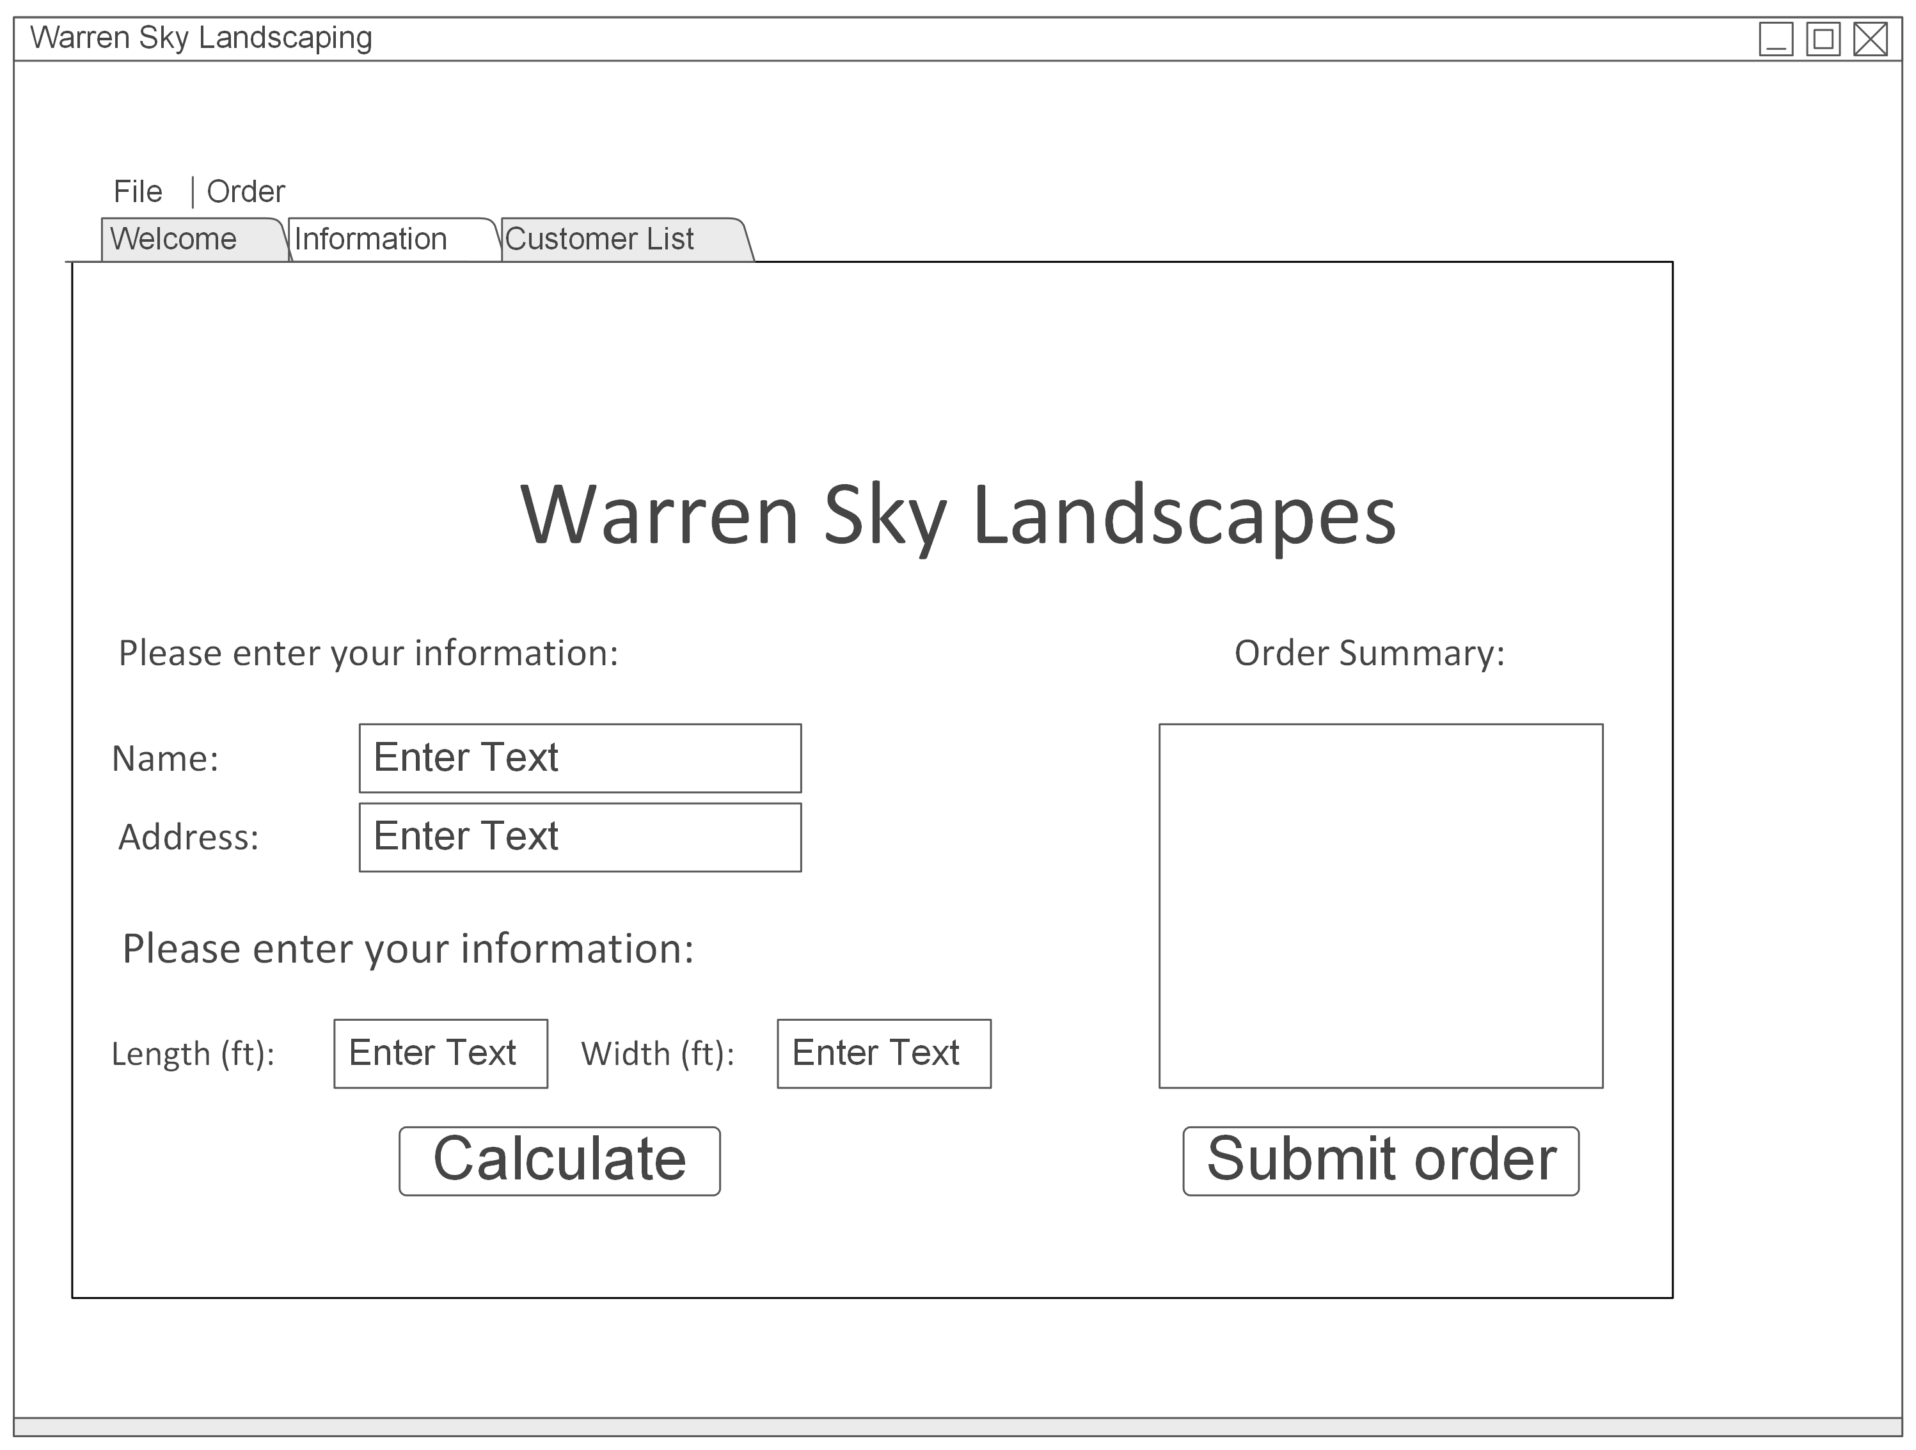
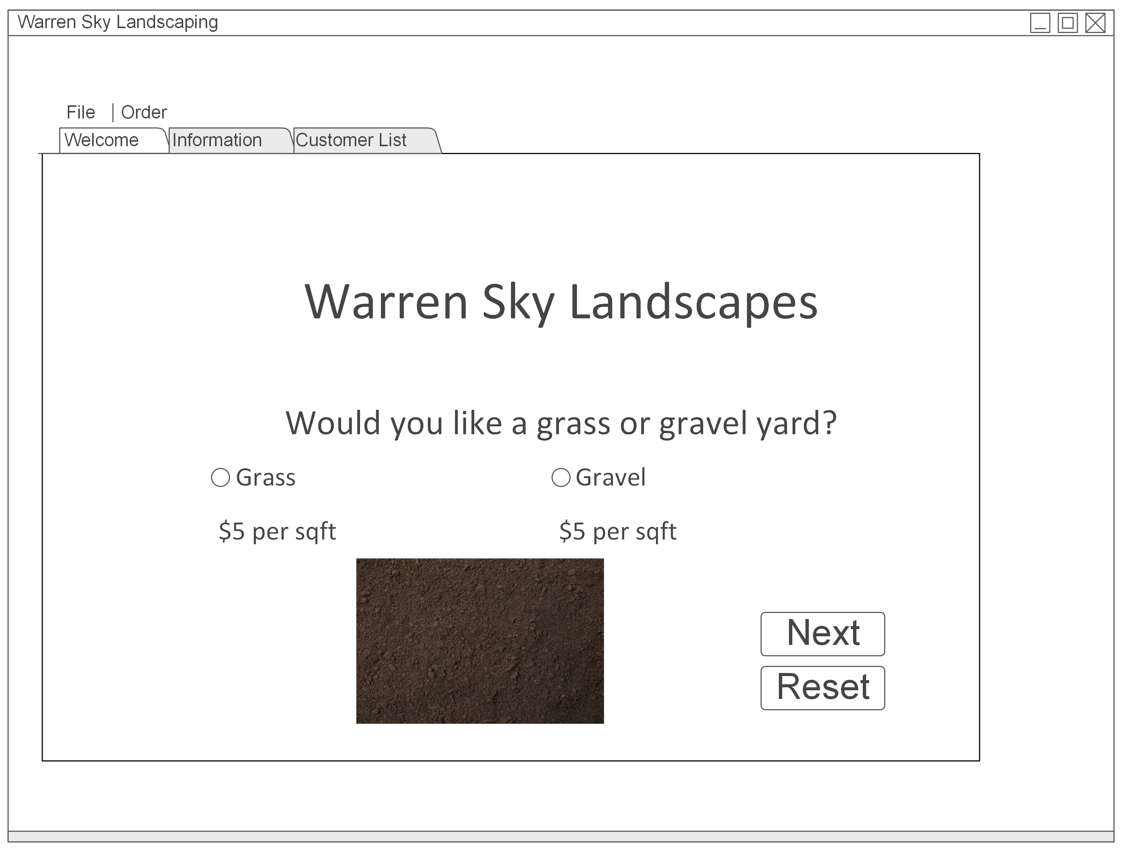
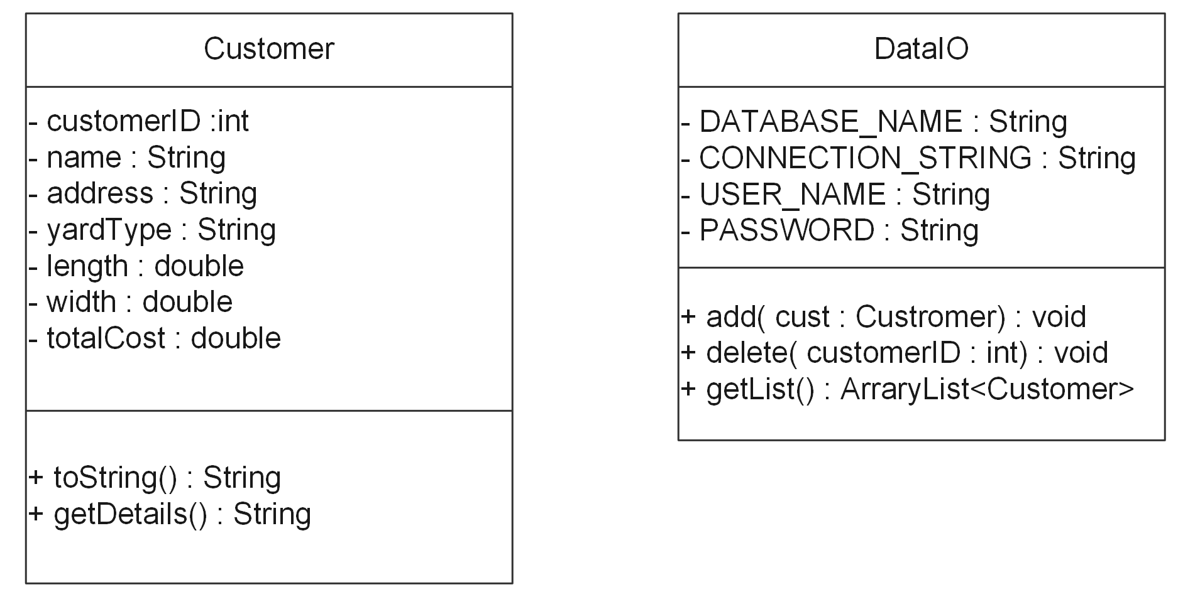
Part 1
I started this project by completing wire and UML diagrams of the application.

Slide 4
Part 2
Now that the design is complete the coding begins

Slide 5
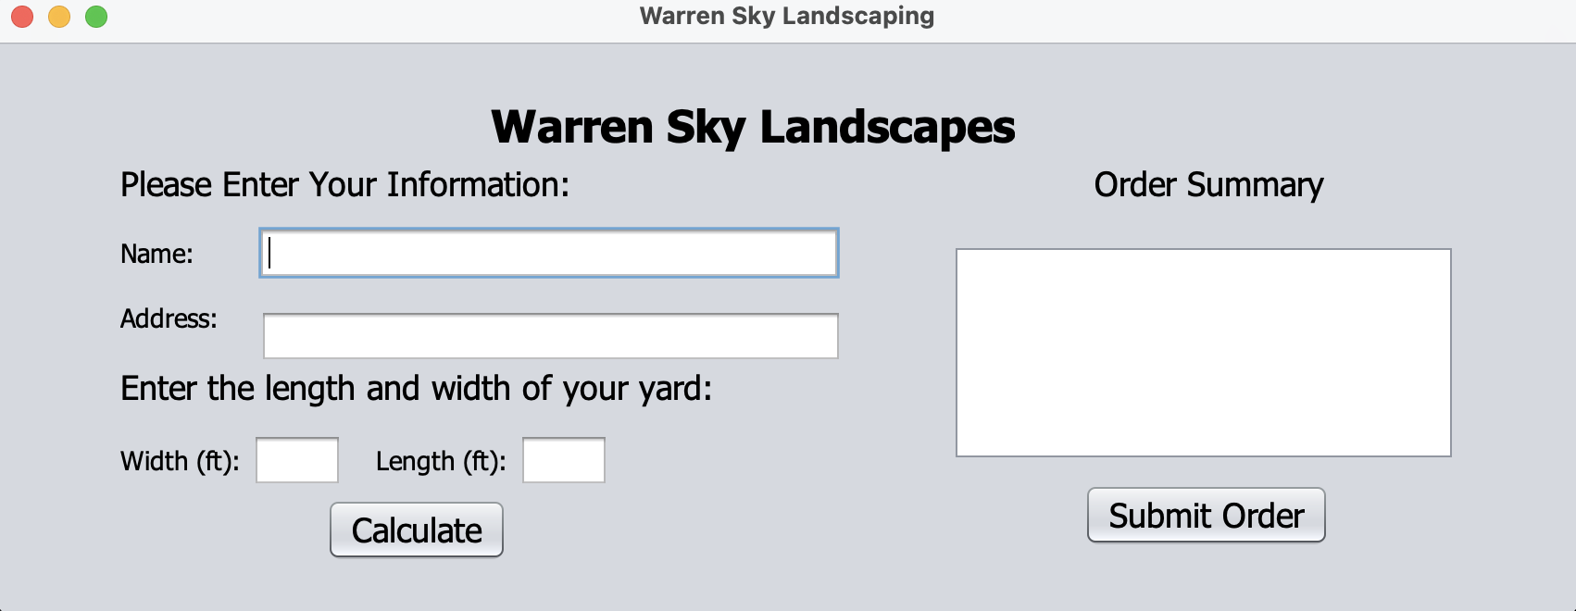
Using the UML and wire diagrams as a guide I began to code the GUI staring with the creating the JAVA project in NetBeans IDE. Then created the JFrame GUI class using NetBeans and created the Customer Class and added the first of my components.

Slide 6
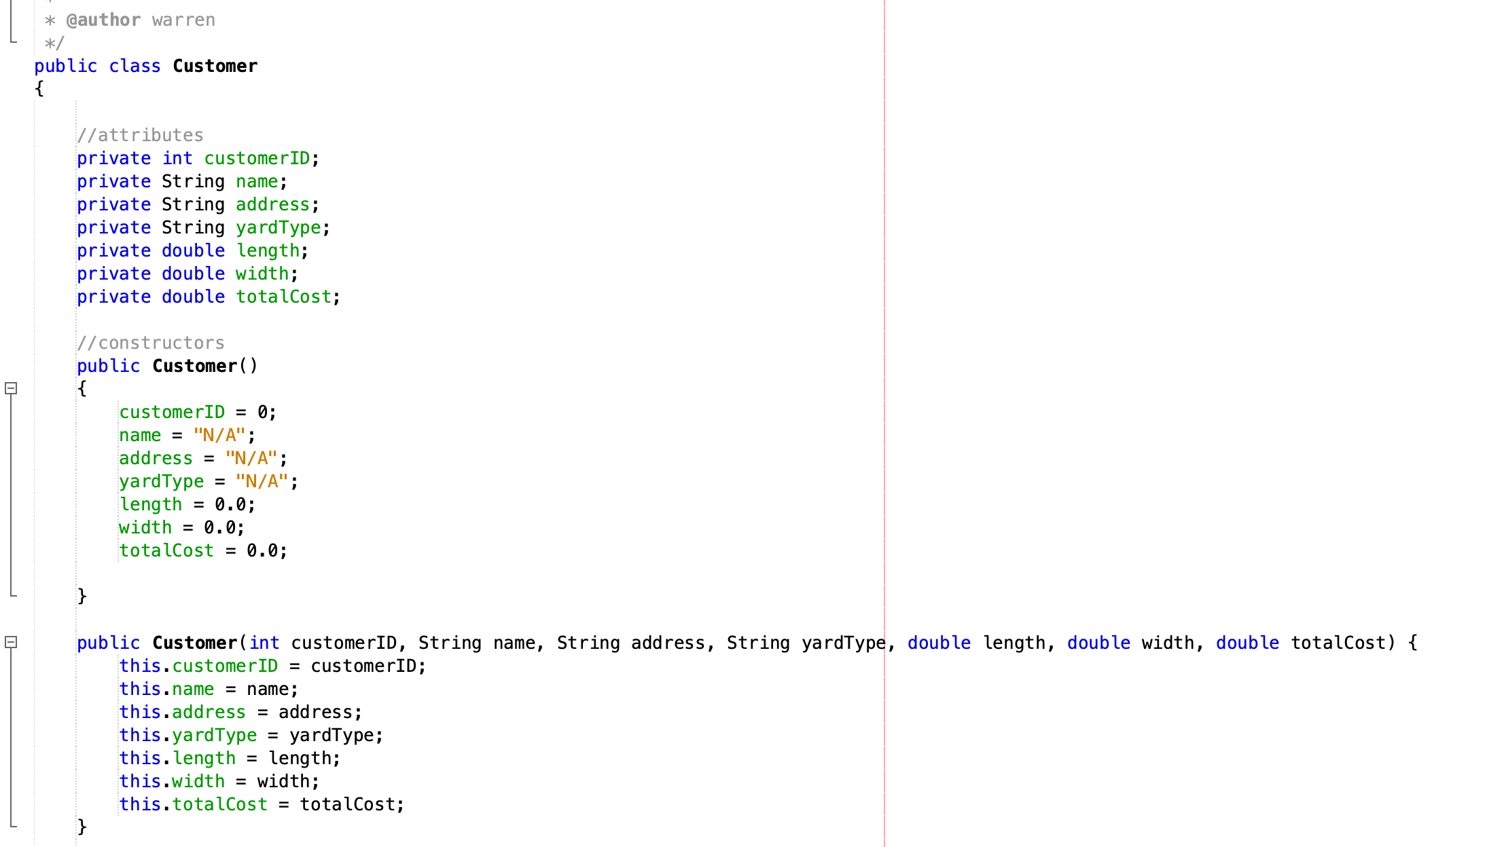
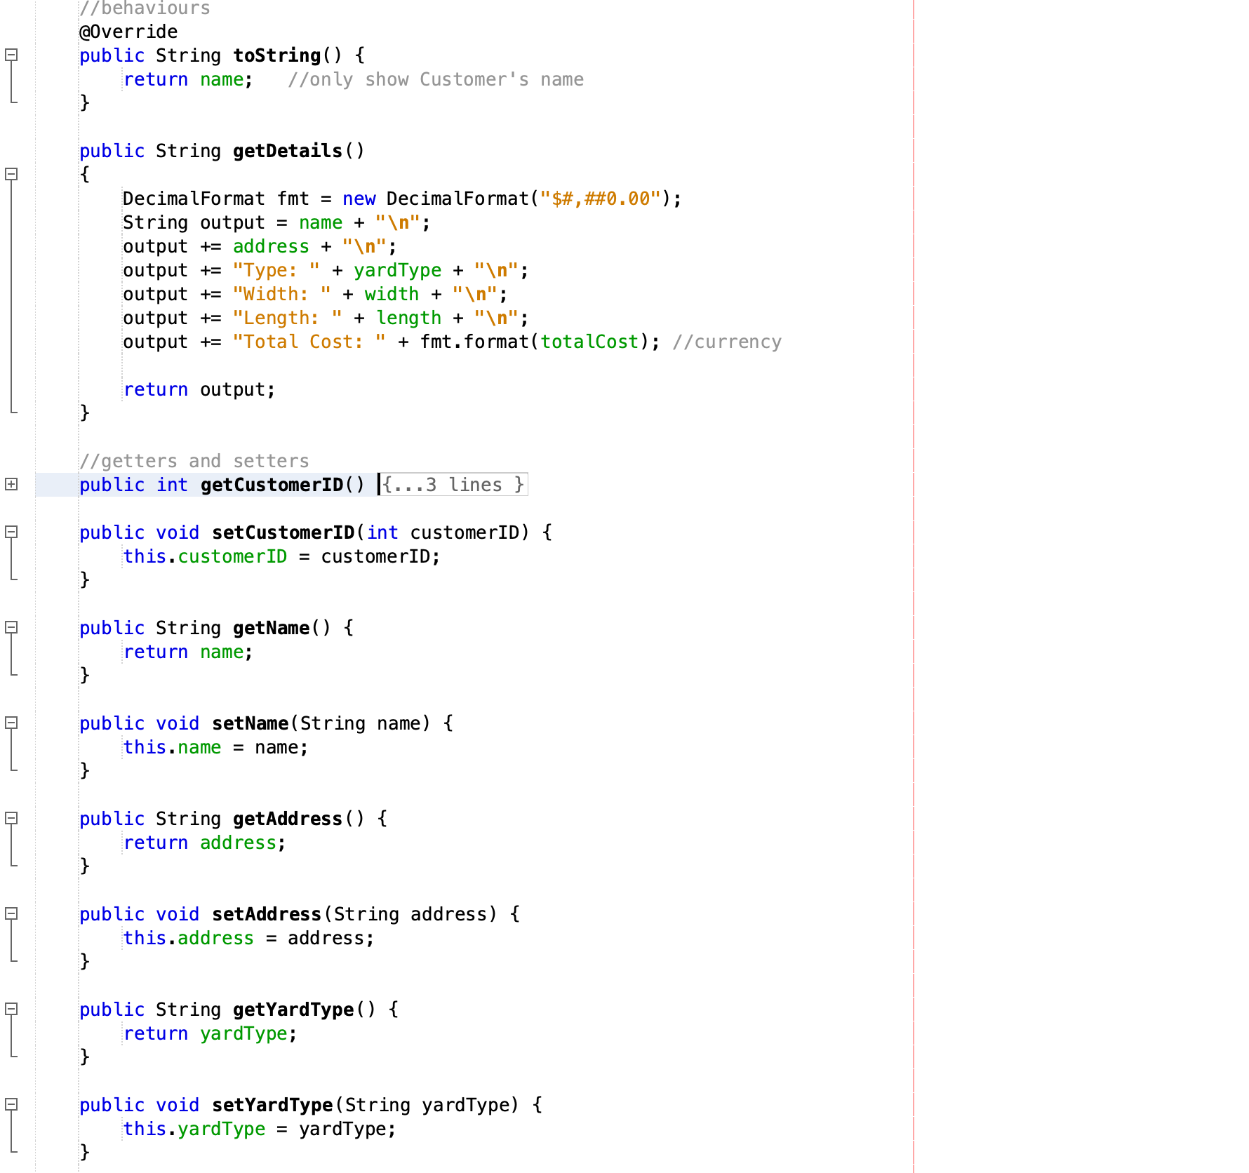
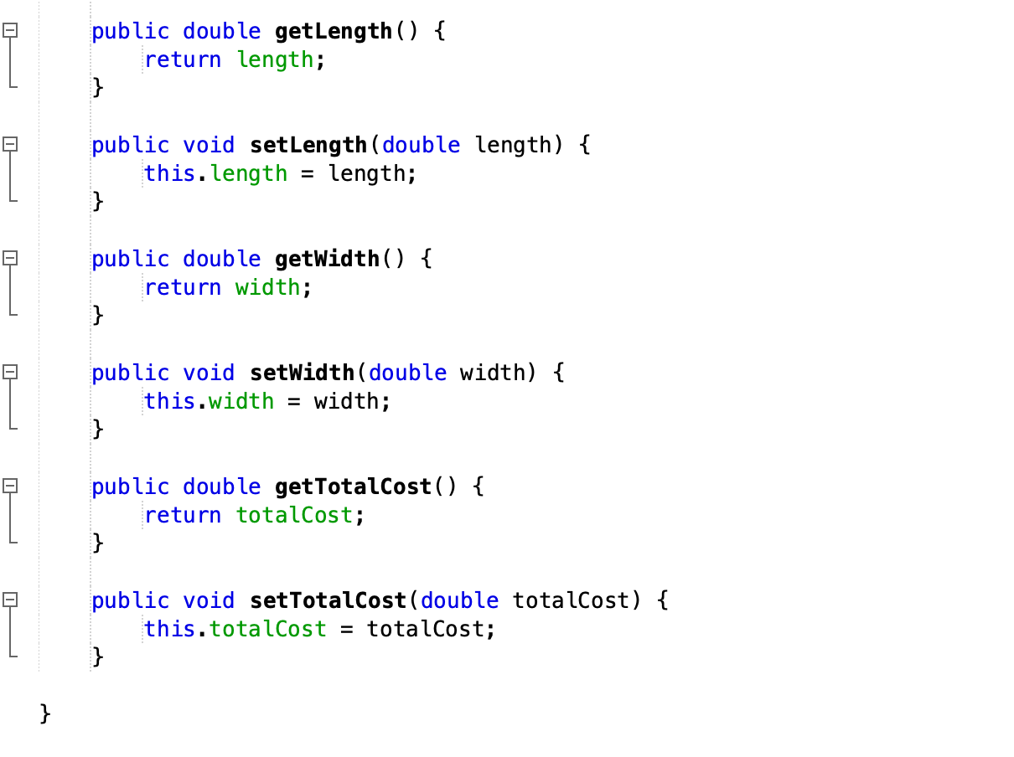

Slide 7
Part 3 Advanced Controls
This phase of the project includes adding a new window to the application for order options. The new window will have radio buttons which control changes in the application based on user selection. In this case the choice is the type of yard material and the change is a picture depicting the choice identified by the radio button.
I also added menus and functionality to the Next and Reset buttons

Slide 8
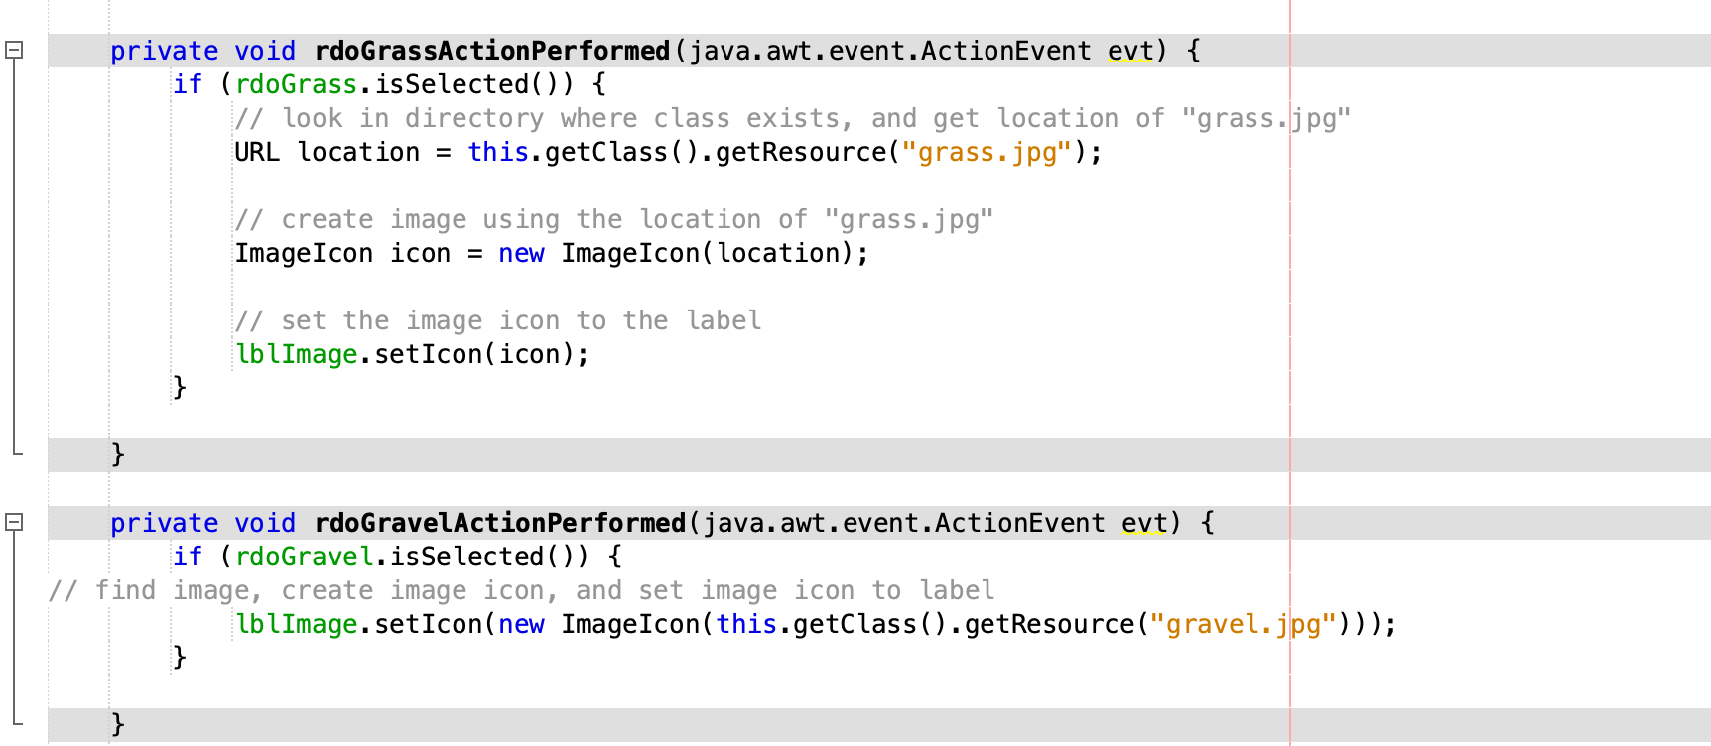
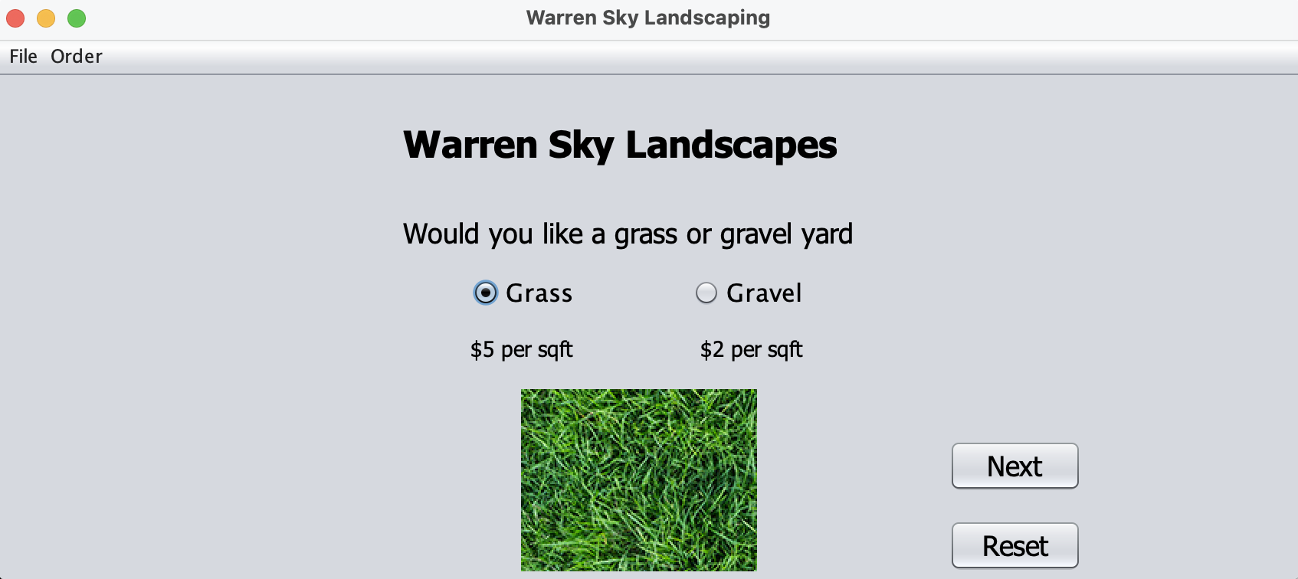
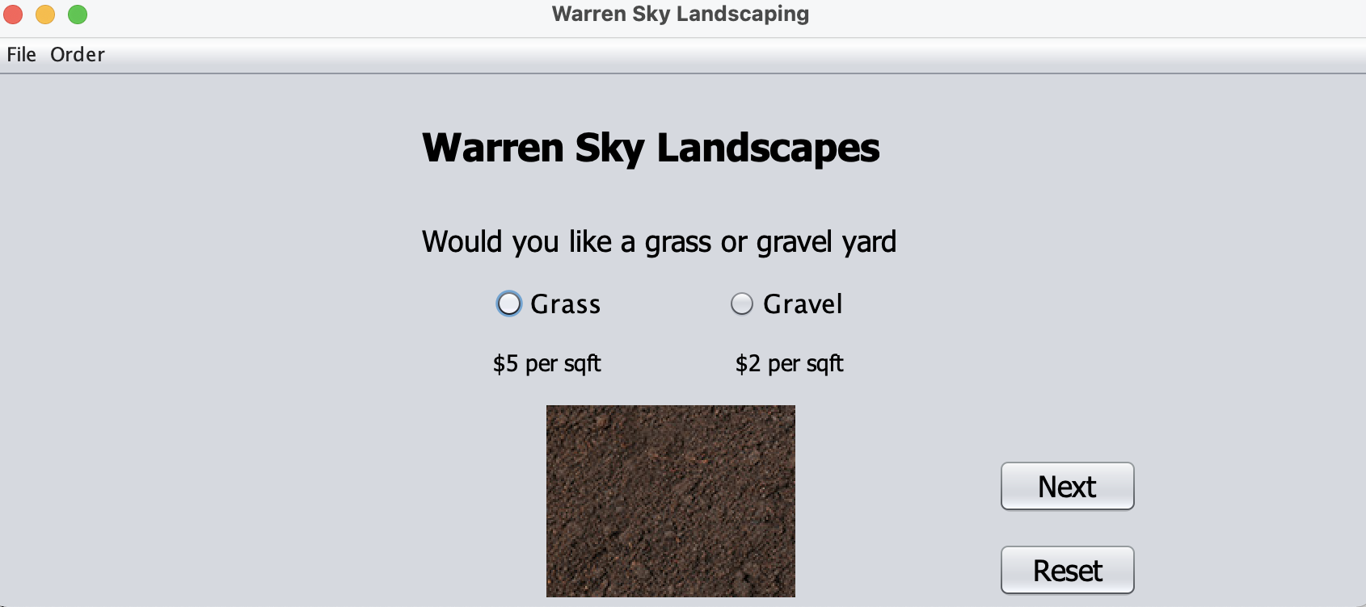
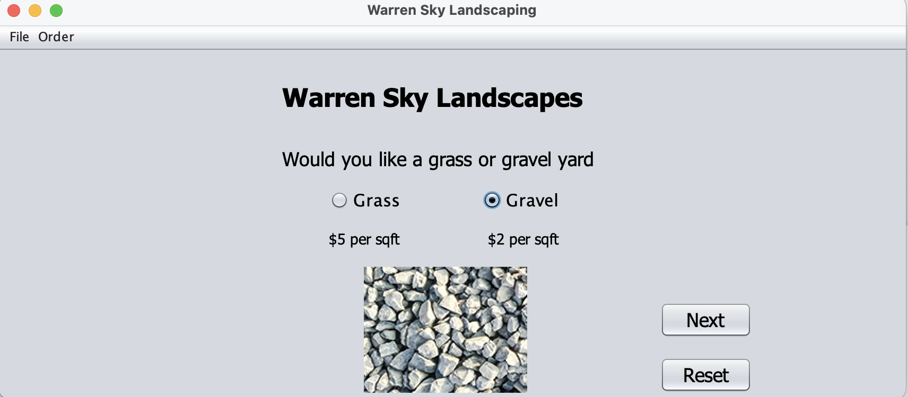
Radio buttons

Slide 9
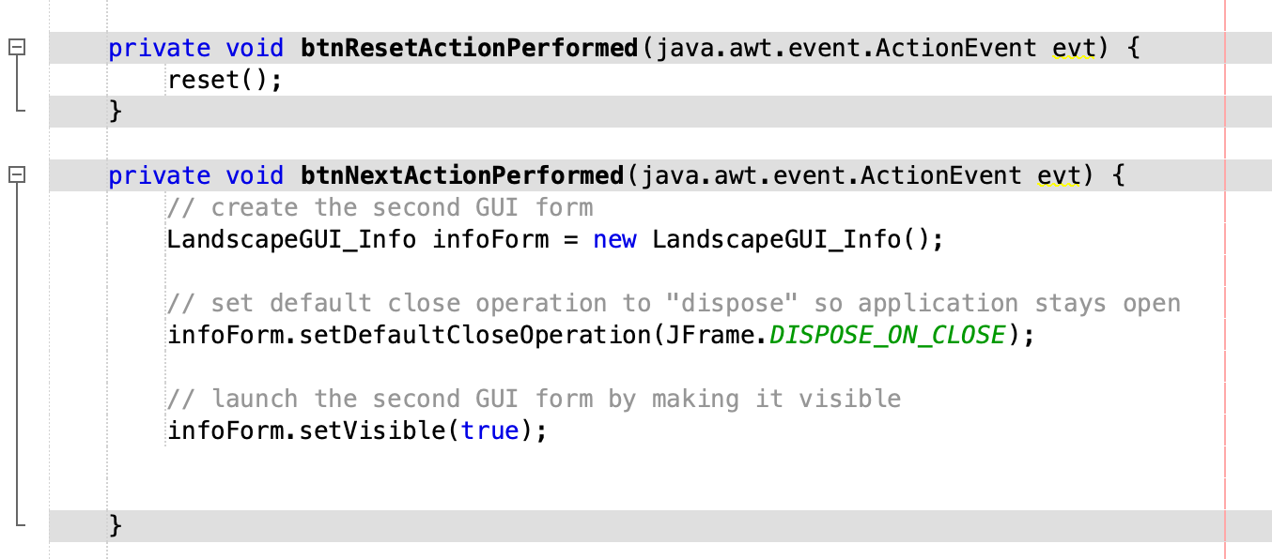
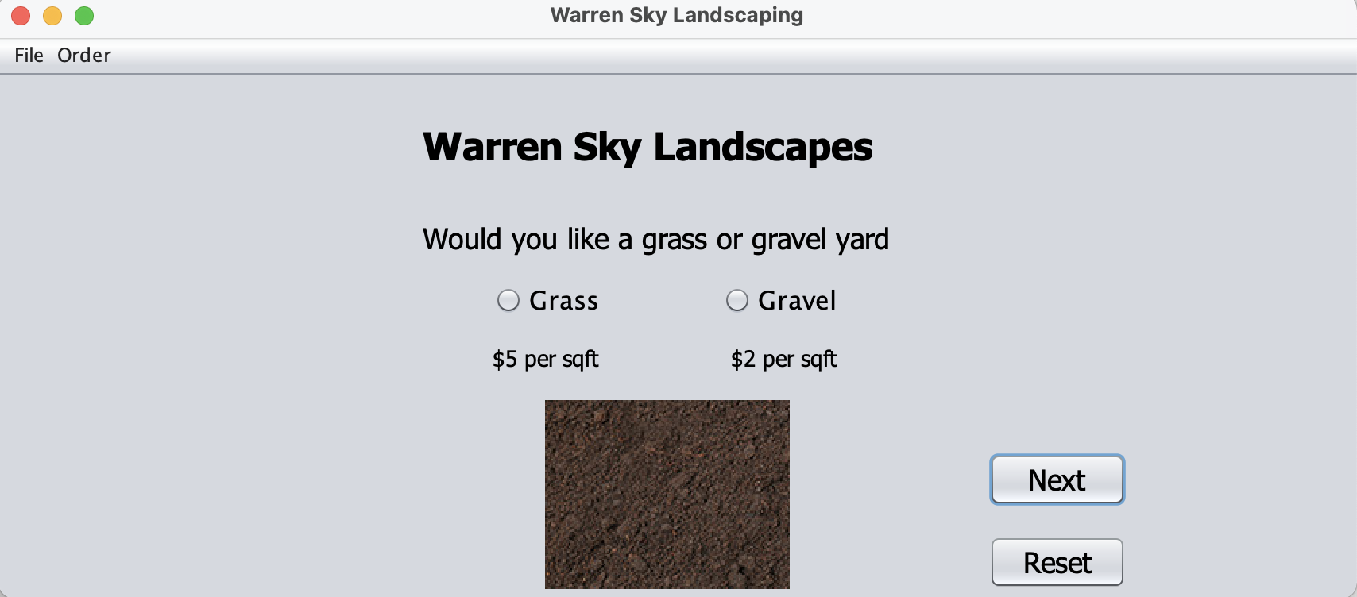
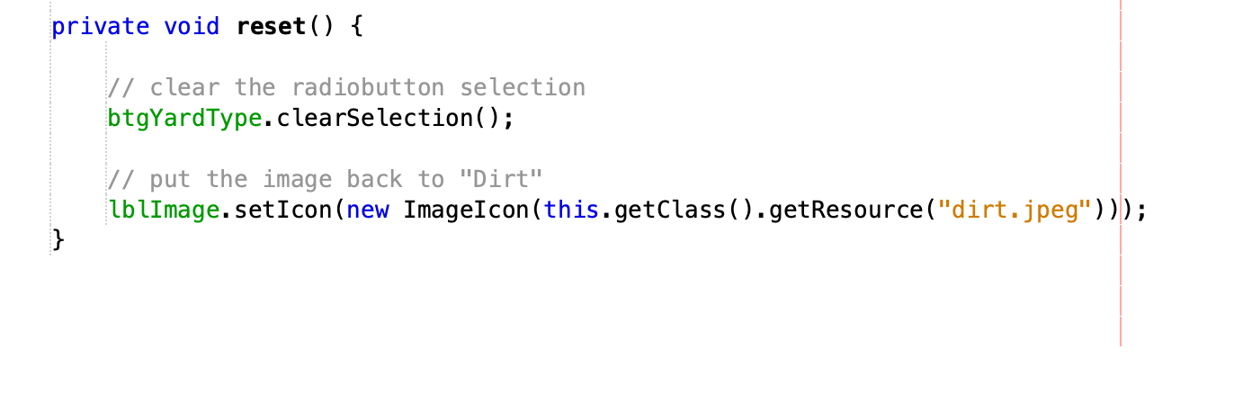
Functioning JButtons
Code for reset method which the JButton calls

Slide 10
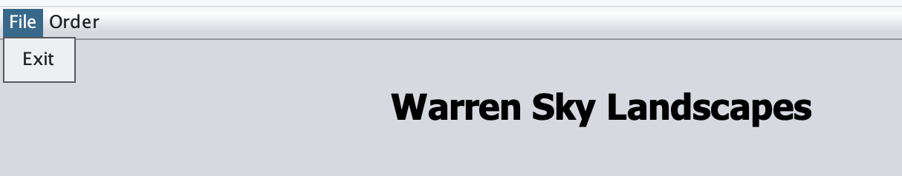
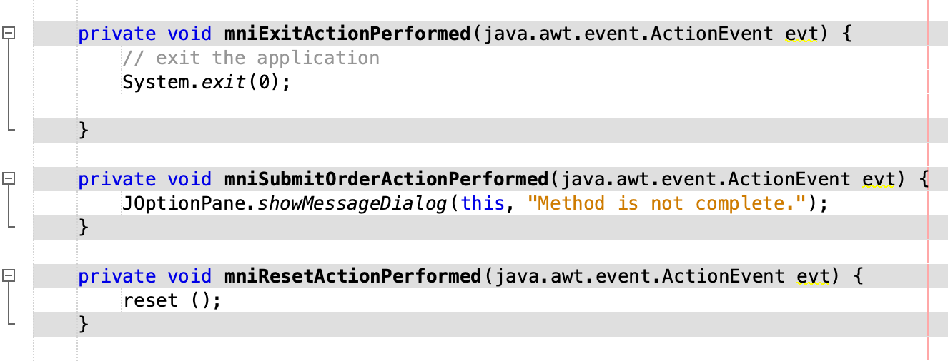
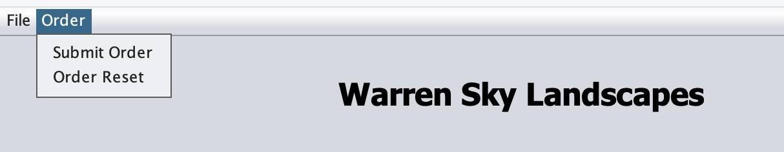
Functioning Menus

Slide 11
Part 4 Tabs, ArrayList, JList
In this phase of the project I added tabs to switch between application windows.
A new Customer List window was added to which a ScrollPane with a JList to display the Customer List. A second ScrollPane with a JTextArea was added to display the details of the customer selected in the Customer List.
Load List and Delete Customer buttons were added to the Customer List window but only the Delete Customer button was made fully functional. A “Method Not Complete” message serves as a placeholder for the Load List functionality.

Slide 12
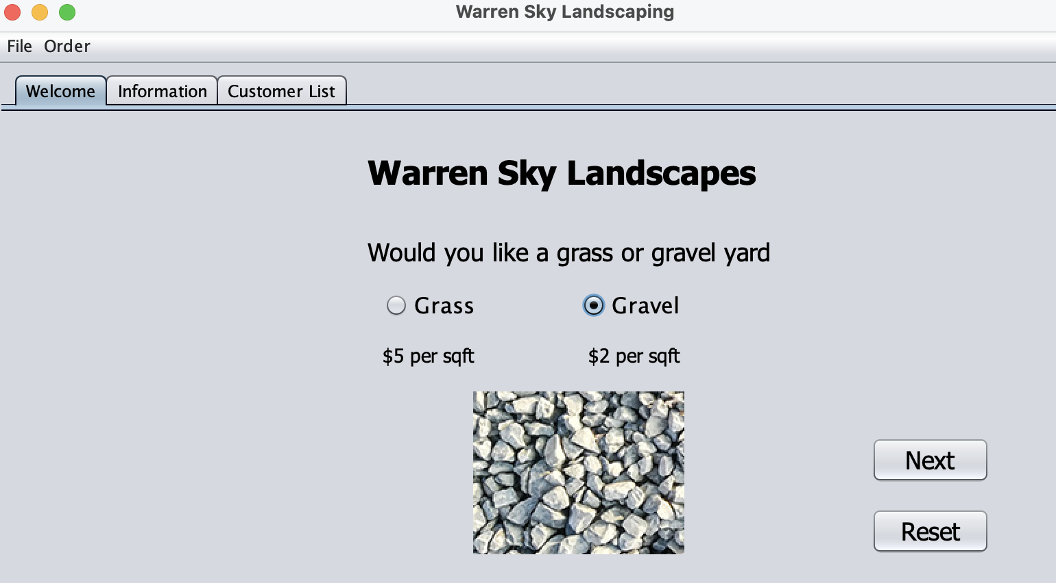
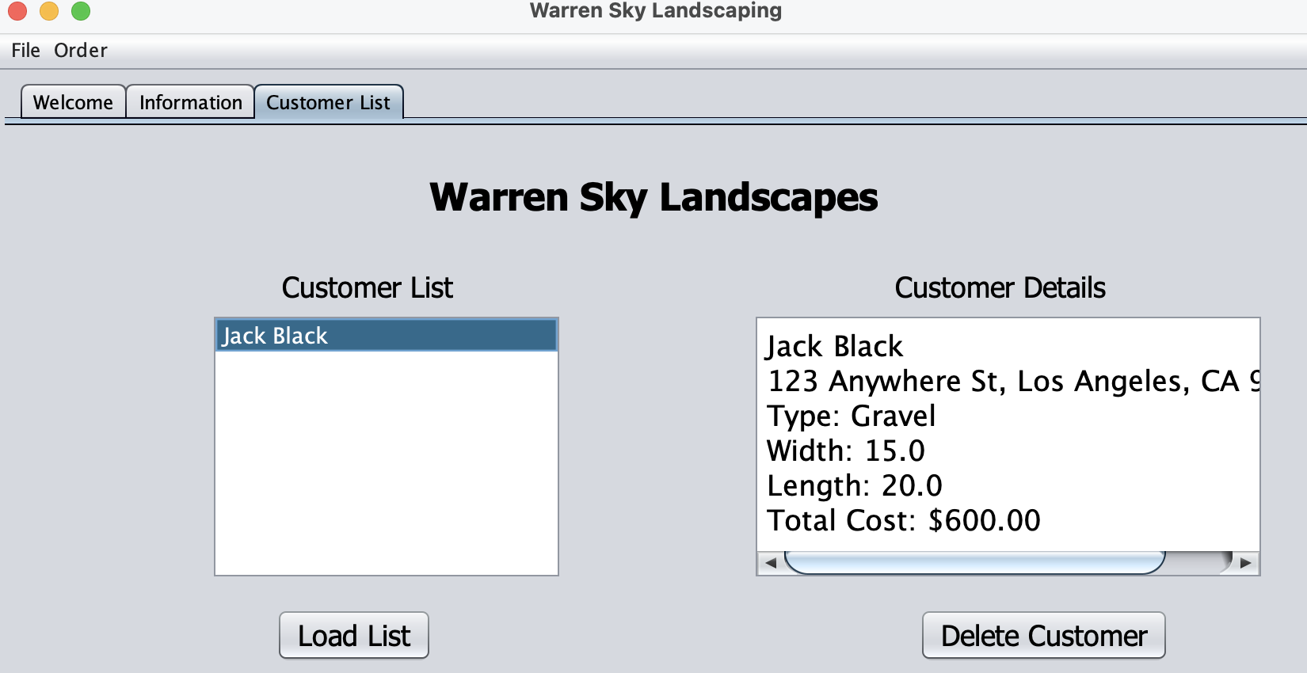
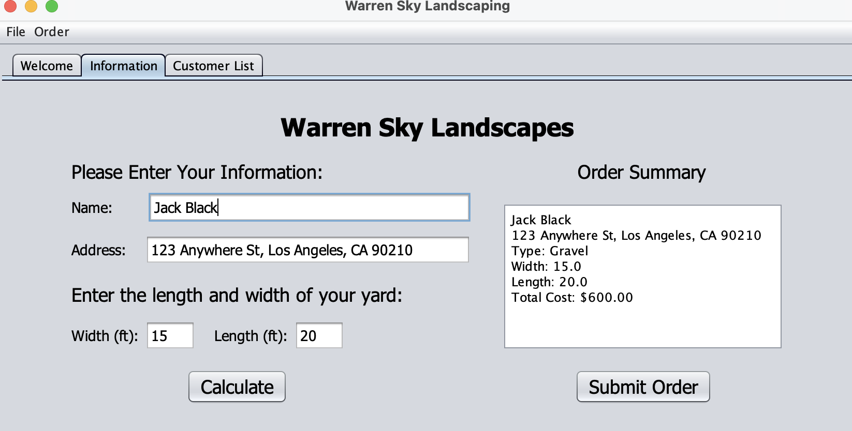
Screenshots of tabbed windows

Slide 13
Part 5 Read and Write to file
Now that the application is working maintaining the customer information is the next part to be completed.
Thus far the customer and order information is only displayed not stored after the application is exited. The Data I/O Class is created and functionality is added to the Load List button in the Customer Information window.

Slide 14
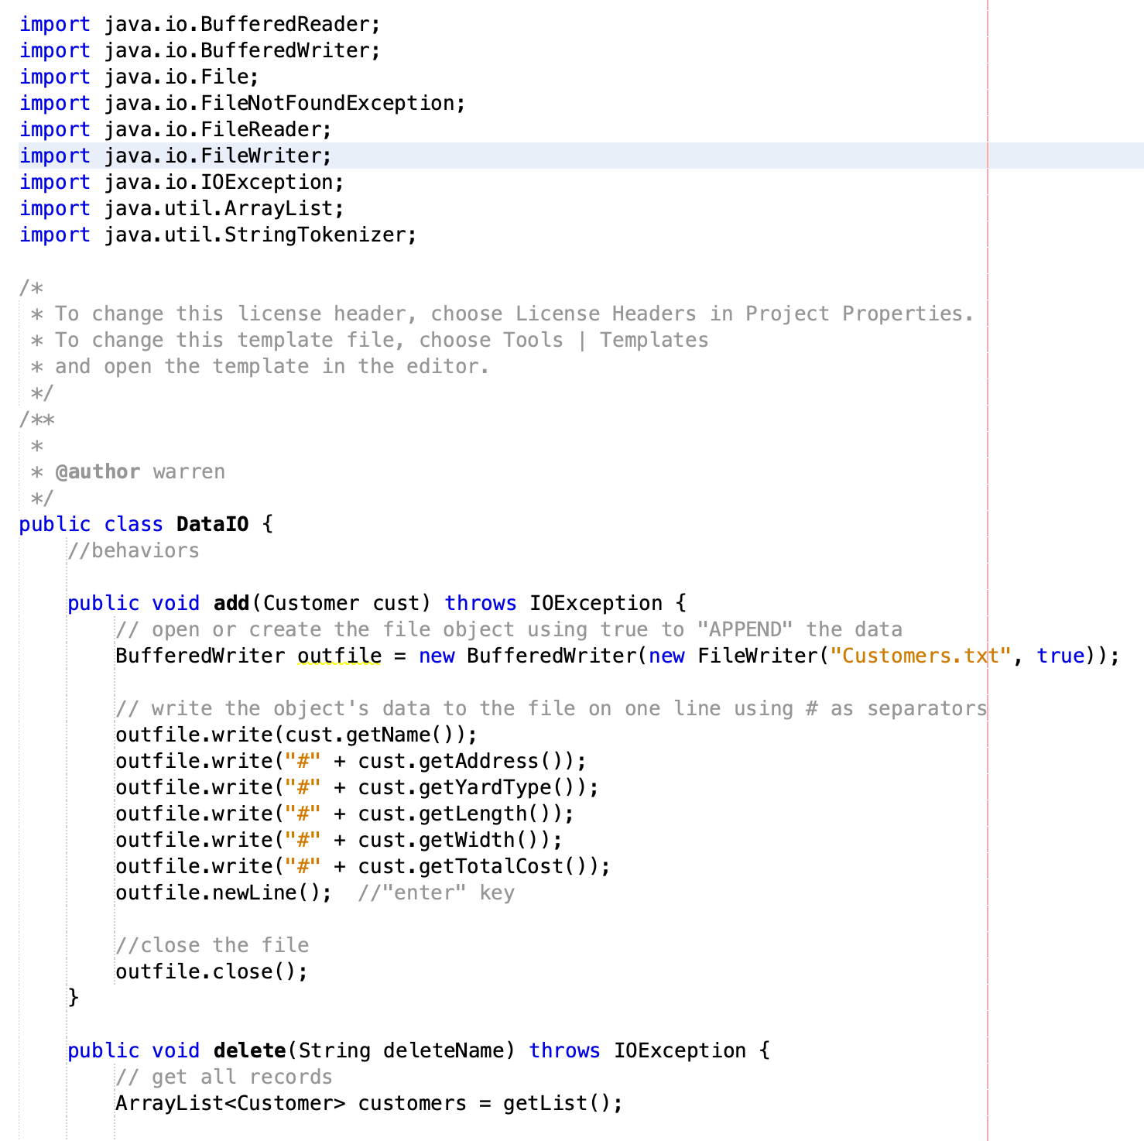
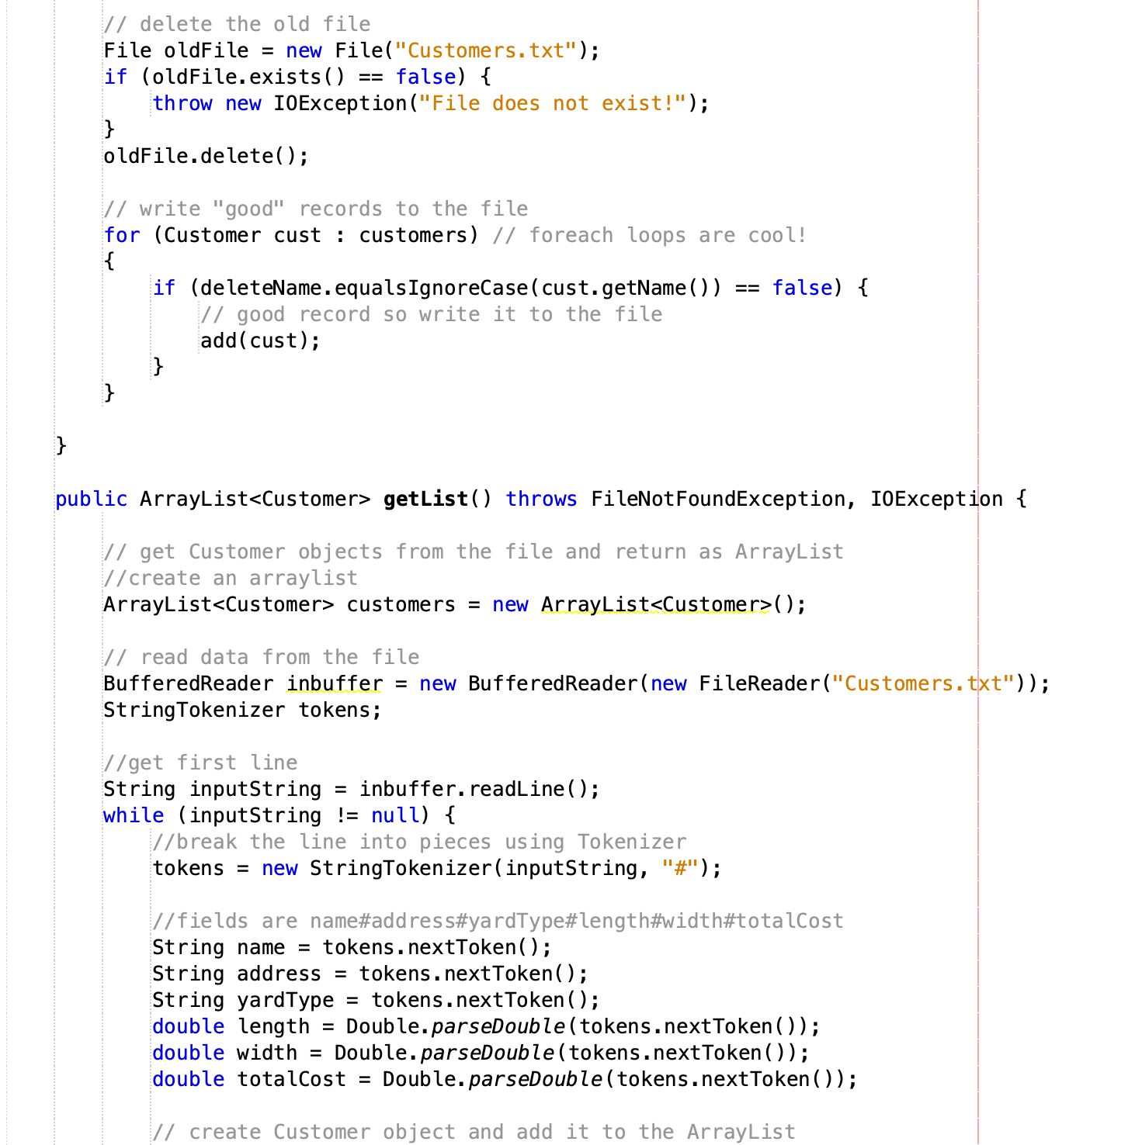
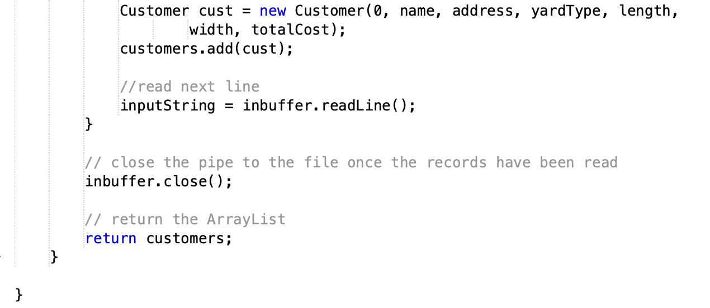
Data I/O Class coded

Slide 15
Part 6 Read/Write to database
While writing customer data to a file is great for storage, the functionality beyond that is limited. By writing to a database, the data can be utilized beyond the application. An example would be using the stored customer data to conduct business analytics. A MySQL database was created for this purpose.

Slide 16
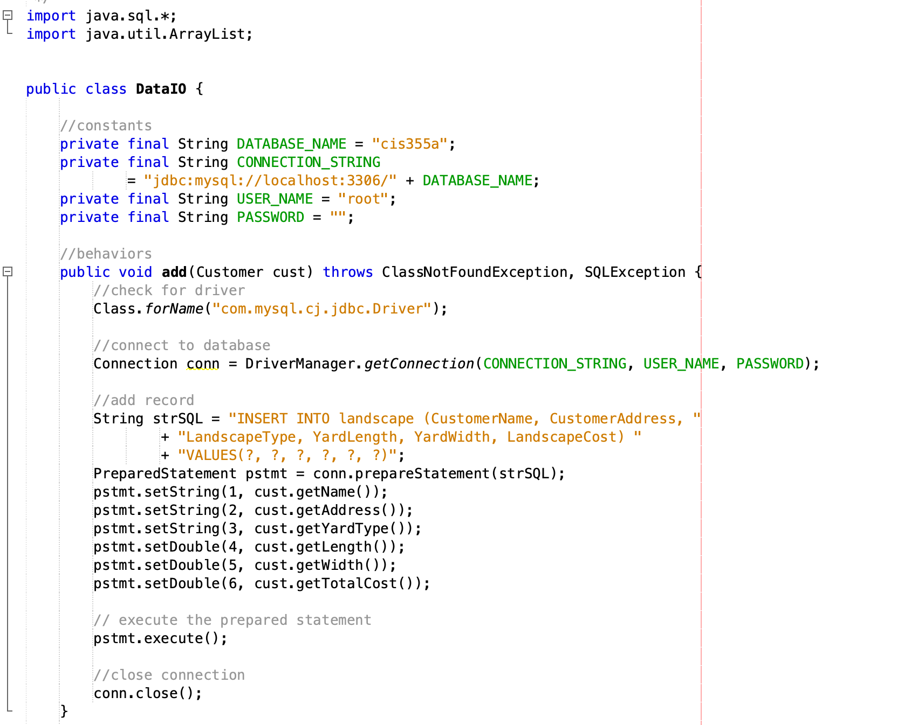
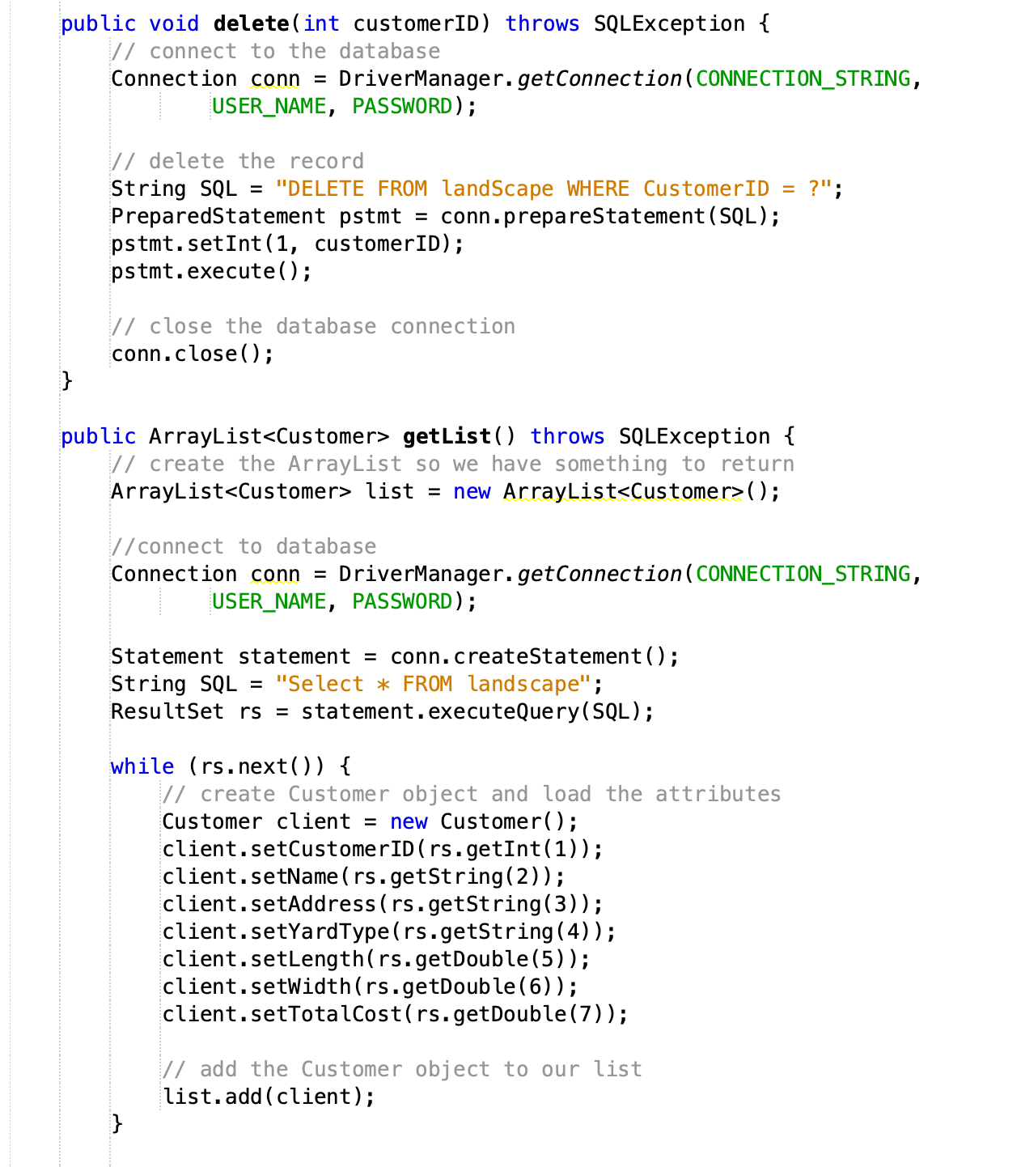
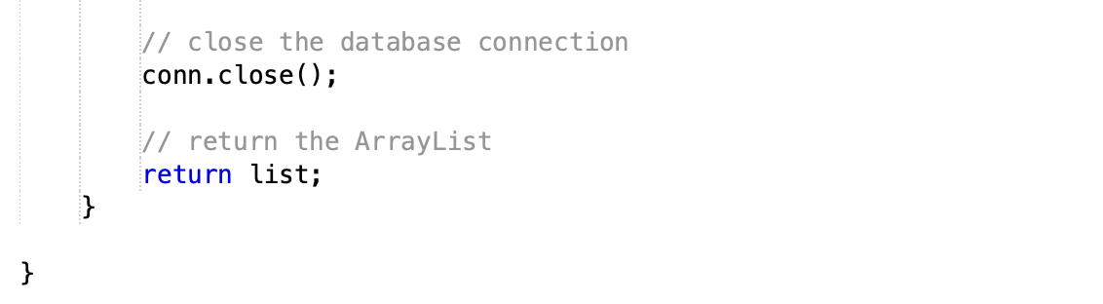
Data I/O Class code which now writes to MySQL database

Slide 17
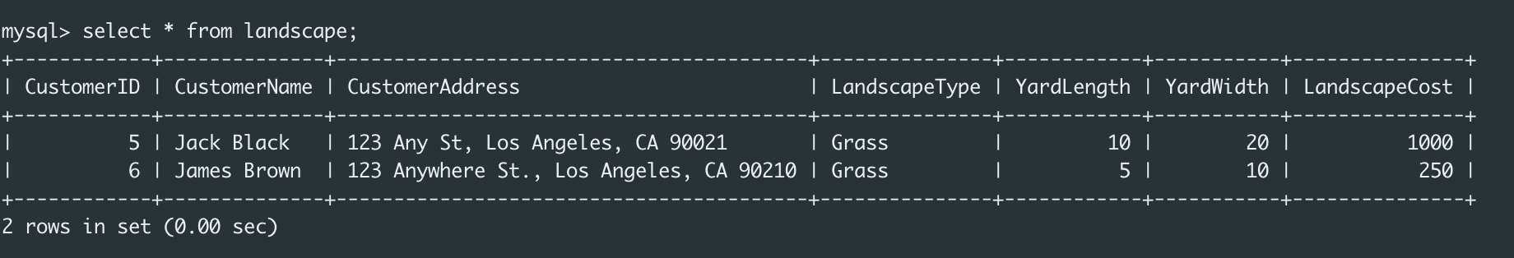
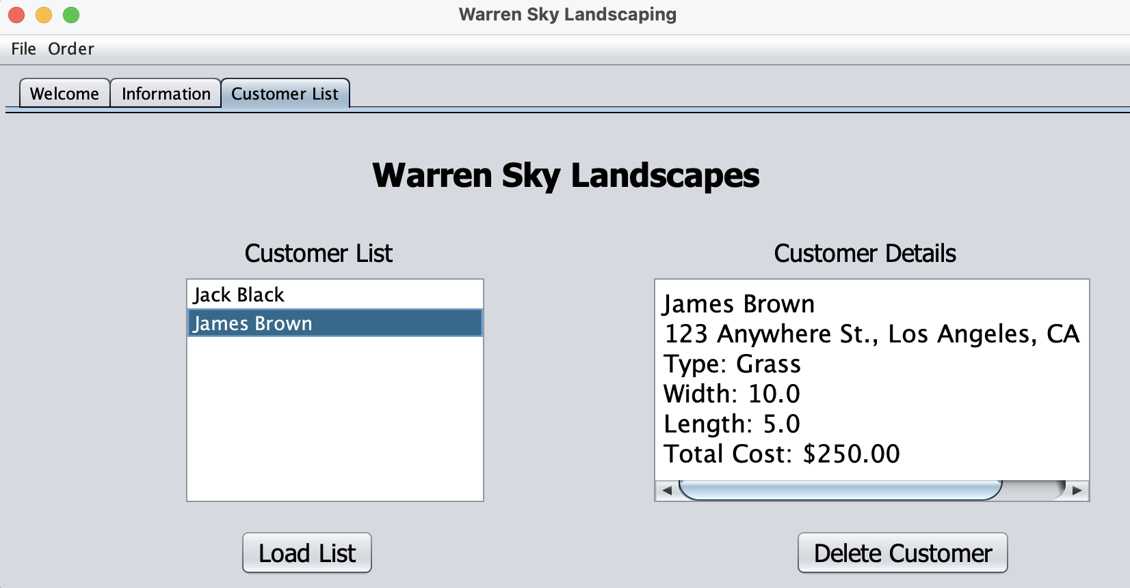
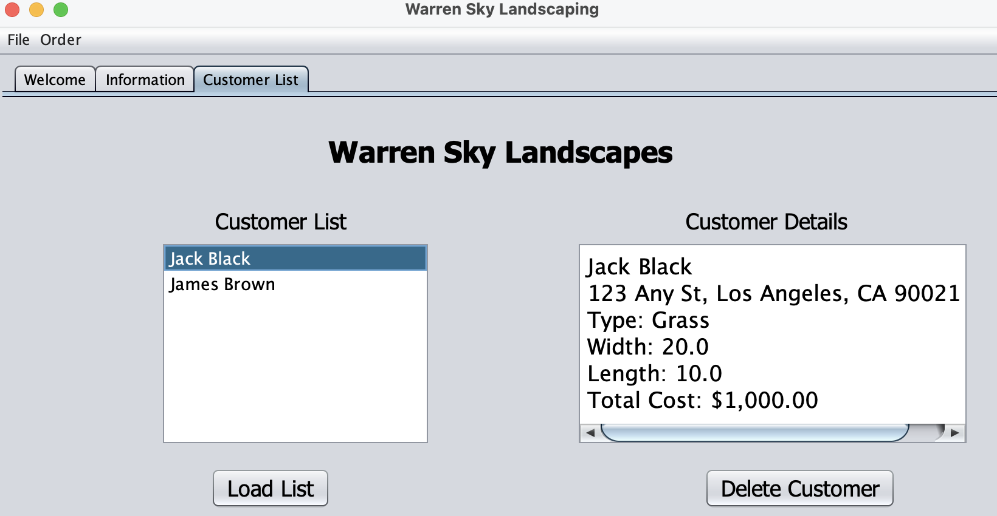
Functioning Customer Database

Slide 18
Challenges
Being careful that cases match when making references. For example I had the tendency to capitalize in one place and not in another for variable names.

Slide 19
Career Skills Learned
How to use NetBeans IDE to create and manage a JAVA development project
How to create a GUI application from UML and wire diagrams
How to code a GUI application to read and write information to a database

Slide 20
Conclusion
With Java being such a popular programming language, being able to produce a GUI, write the supporting classes and methods to support required functionality as well as write to either a file or database is an extremely valuable set of skill to have been able to demonstrate.

